Slide 1
MasterSchool
19 SEP 2023

Slide 2
Mastery Projects
Second Submission Deadline: Sept 25
Second Feedback Received By: Oct 16

Slide 3
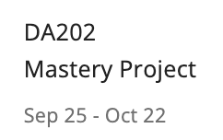
the week of 9/25 is Vacation Week for the March cohort
After Vacation week

Slide 4
Github Repos

